Slide 1
OR GATE
A | B | A+B
0 | 0 | 0
0 | 1 | 1
1 | 0 | 1
1 | 1 | 1

Slide 2
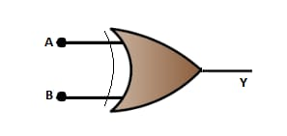
OR GATE
0
0
0

Slide 3
OR GATE
1
1
0

Slide 4
OR GATE
0
1
1

Slide 5
OR GATE
1
1
1

